Slide 1


Team Endpoint
2023-6-24
</
ENDPOINT
/>

Slide 2
</ Table of contents
{01
{04}
Introduction
Product Demo
{02}
05}
Problem
Future and Beyond
{03}
Model Explained !

Slide 3
01
Introduction
</>
{ / }

Slide 4
</ Introduction
The increasing prevalence of drowsy driving incidents necessitates the development of an intelligent system that can proactively identify signs of driver fatigue. The absence of a robust and efficient drowsiness detection technology hinders the prevention of accidents caused by drowsy drivers.
So what we come up with is a drowsy face detector that can track peoples eyes and based on this tells if he/she is drowsy or not in real time and give then a audio alert to wake up. Further more it can also tell give a detailed report of trip after the journey

Slide 5
02
Problem
</>
{ / }

Slide 6
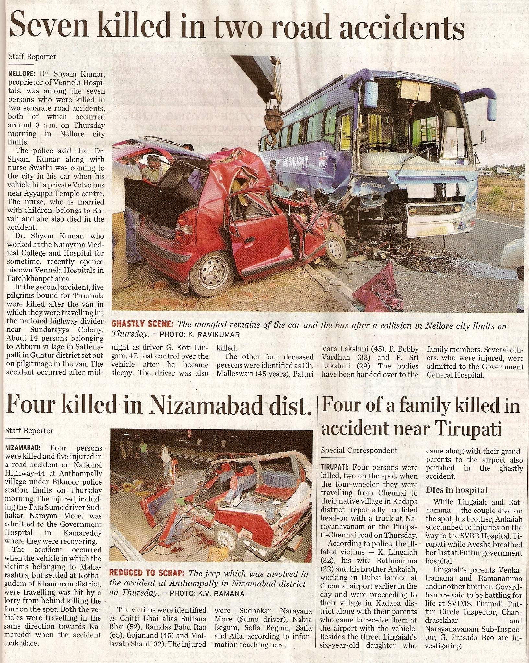
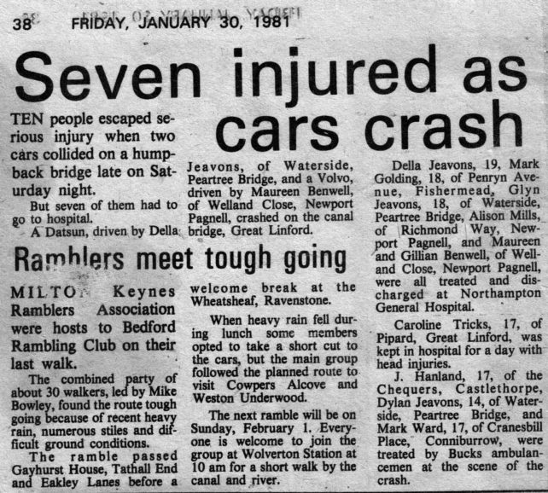
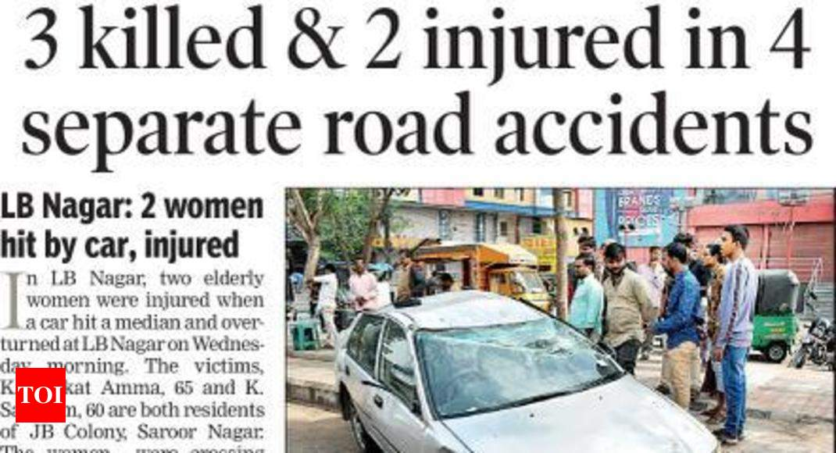
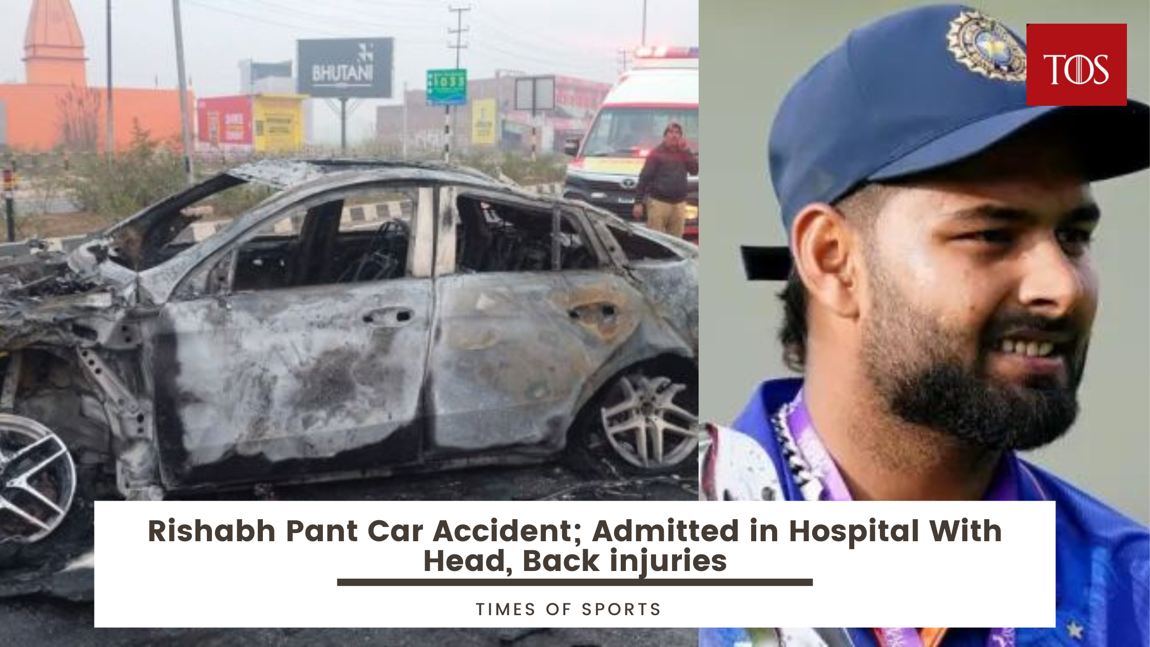
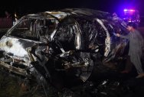

Slide 7
</ Sleepy Drivers
Sleepy drivers in India pose a serious risk on the roads. Factors like sleep deprivation and long working hours contribute to drowsiness behind the wheel, leading to impaired attention and slower reaction times. This issue requires immediate attention to ensure road safety and prevent accidents
Sleepy drivers in India lead to a significant economic loss through increased medical expenses, reduced workforce productivity, property damage, and intangible costs associated with accidents. Preventive measures are essential to minimize these economic impacts and create a safer and more prosperous society.

Slide 8
</ Lets speak NUMBERS
5,01,423
1,47,913
₹350 Cr
Accidents
Deaths
Economic loss
Year | Accident | Deaths
2018 | 501.42k | 151.42k
2019 | 464.9k | 151.41k
2020 | 462.7k | 131.7k
2021 | 302.2k | 73.2k
2022 | 471.7k | 155.6k
Source https://www.financialexpress.com/india-news/40-of-highway-accidents-occur-due-to-drivers-dozing-off/1659901/

Slide 9
03
Model Explained !
</>
{ / }

Slide 10
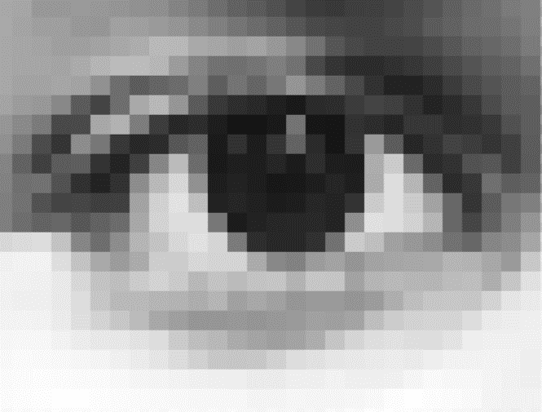
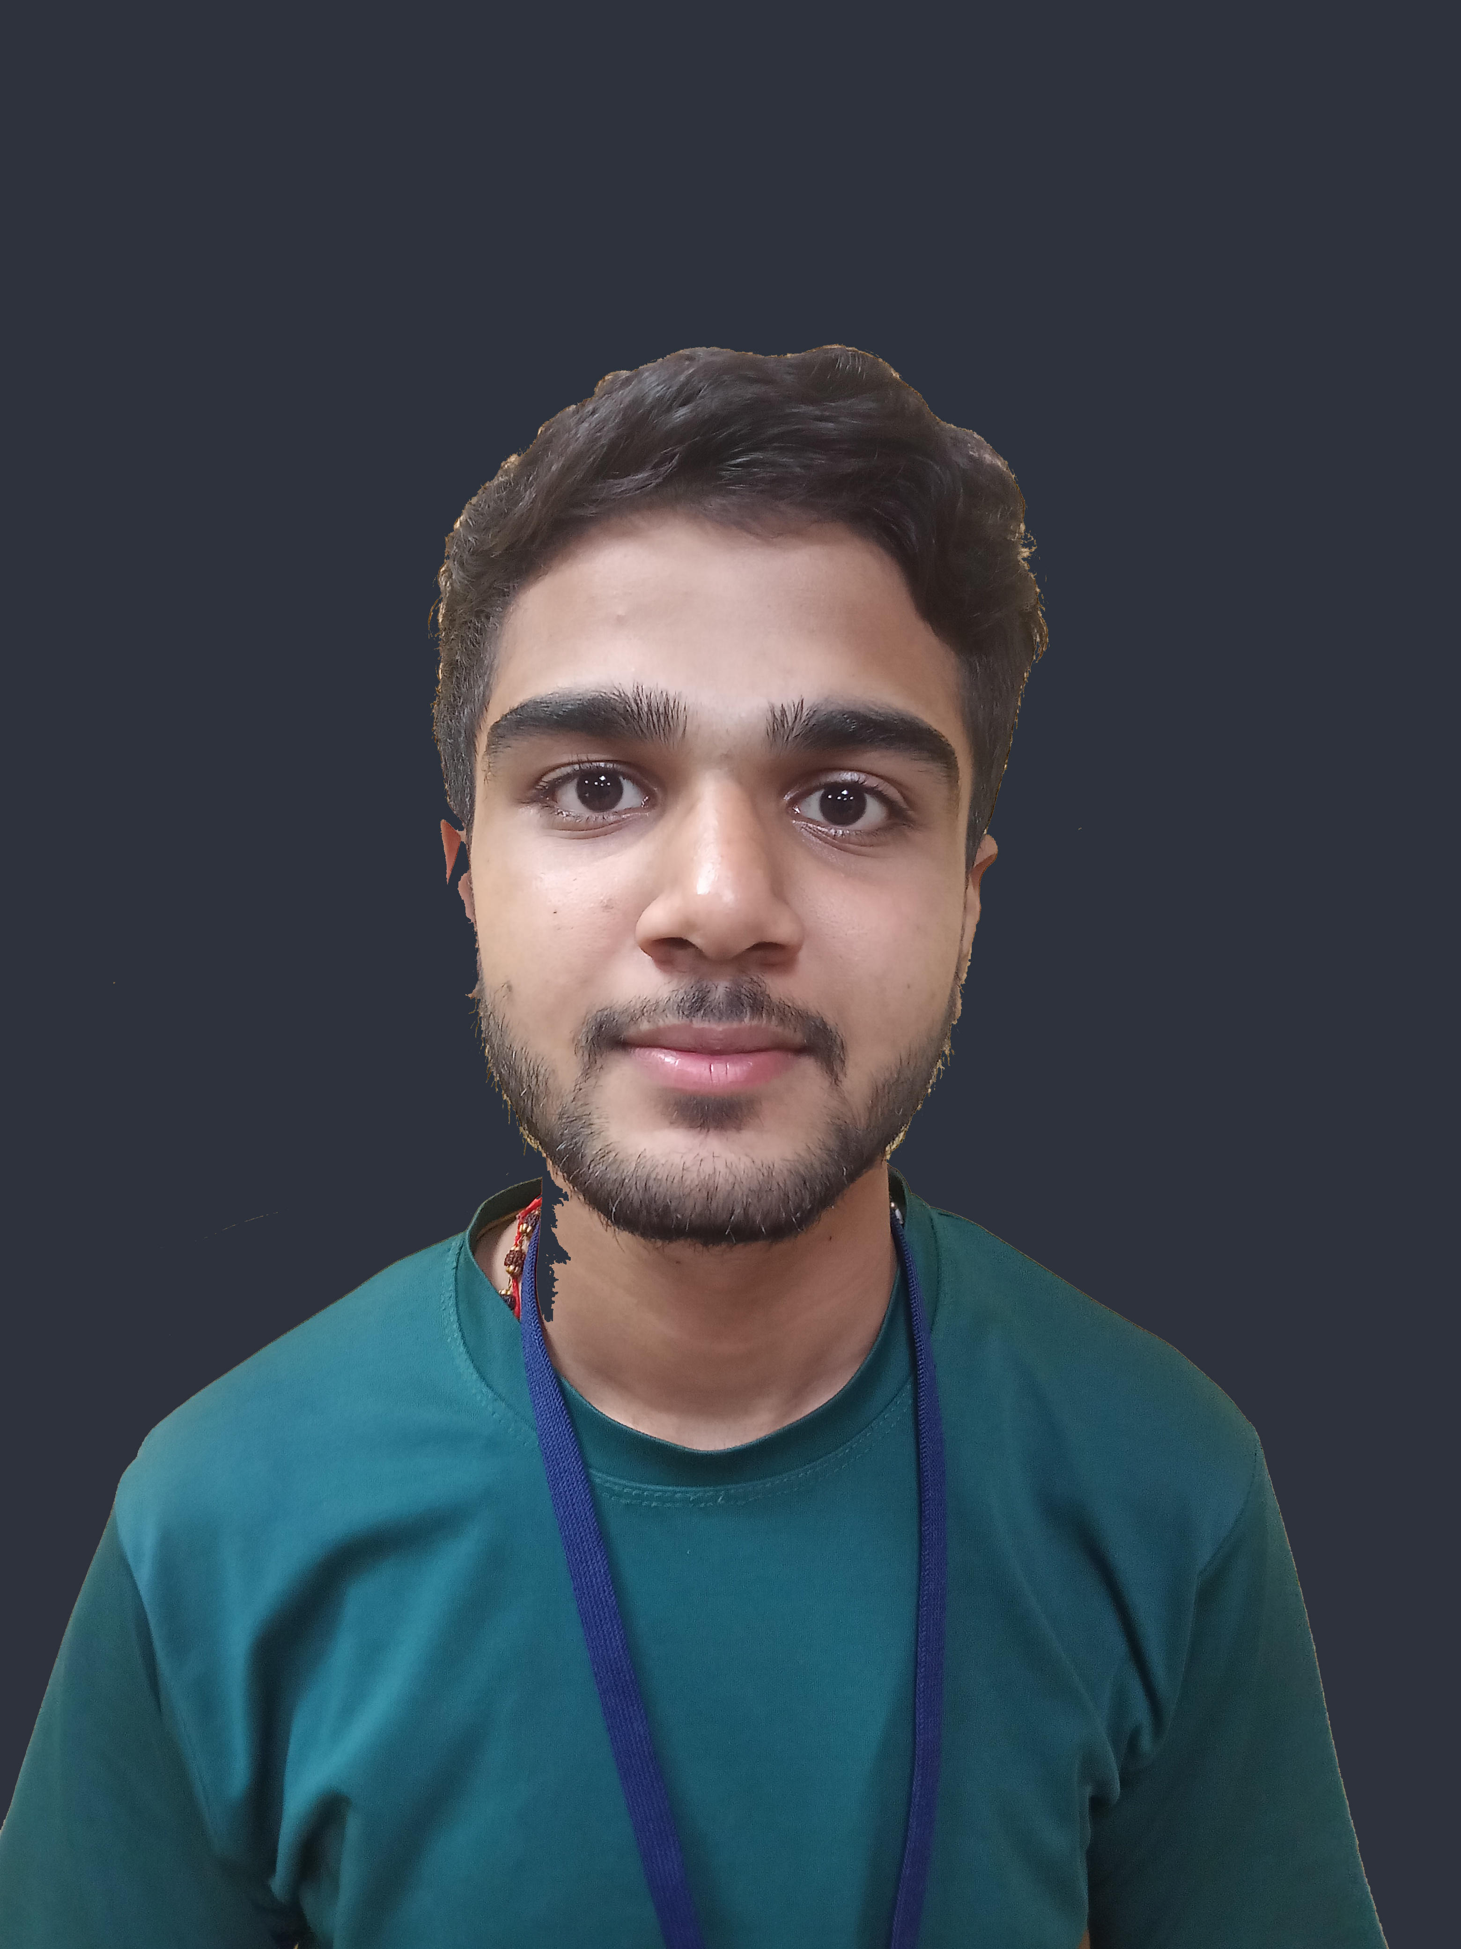
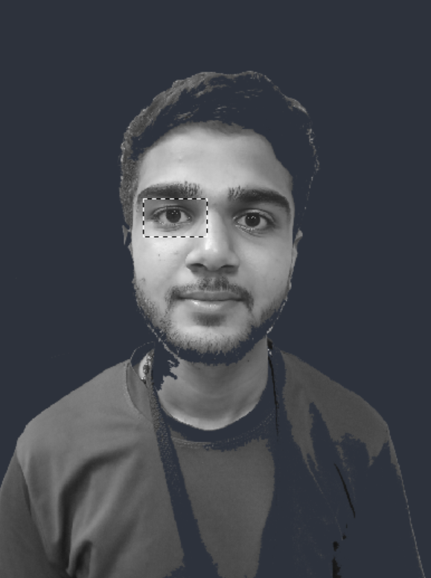
</ Introduction to CNN (Stuff which fuels our project)
Then it convert the images in small parts aka (Segmentation) then apply a filter on it to check weather its similar to a eye or not

Slide 11
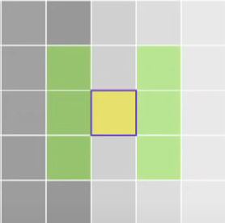
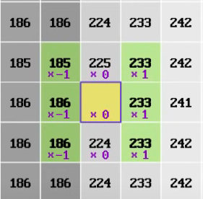
How this Filter Works
-185
-186
-186
+233
+233
+233
147
Which is less than 175 so it’s 0 overall
This is how one filter works there are a lot of similar filter each of them is a week filter which when combined becomes a powerful filter because of the multiple layers and filter it becomes very complex hence it is called a convolutional (complex) neural network

Slide 12
</ This is avalible in cars !
What is standing out in our Product
Works on IR Camera
Plug and Play Design
Cheaper Cost
95.97% Accuracy
Provides Analytics
Simple and Reliable
Fatigue Prediction
Optimal Rest Breaks
Versatile

Slide 13
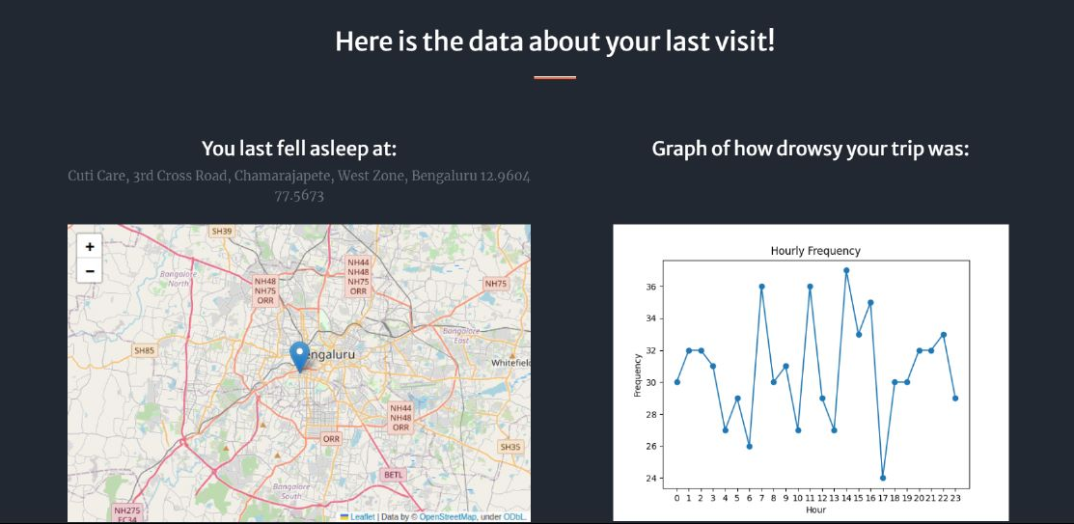
</ Drowsiness time and location log

Slide 14
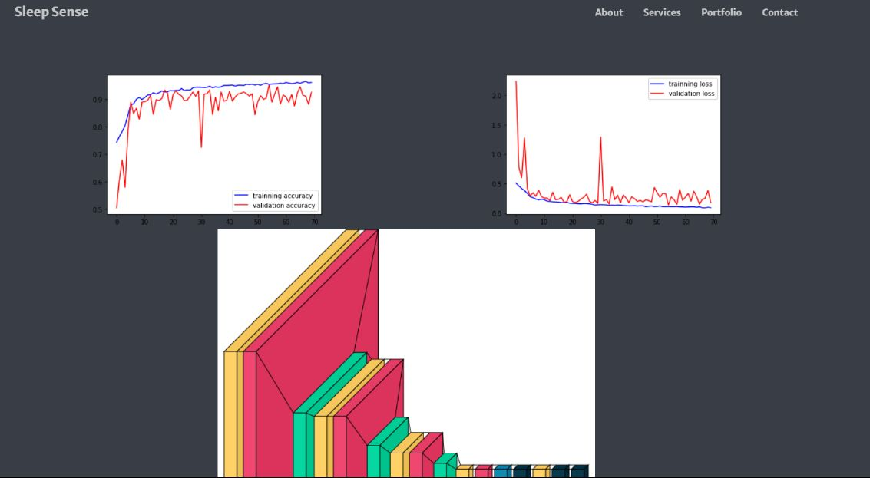
</ Advance Anylatics and Reports

Slide 15
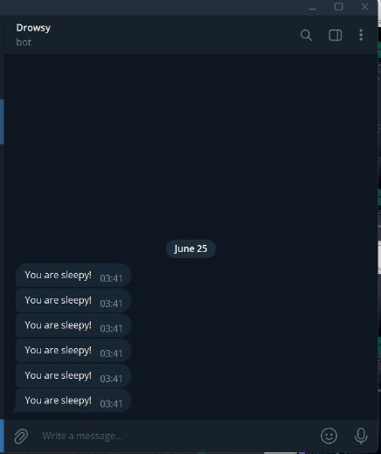
</ Telegram Bot
Yes! By this feature we can send message alerts to family and friends when drivers are drowsy

Slide 16
04
Product Demo
</>
{ / }

Slide 17
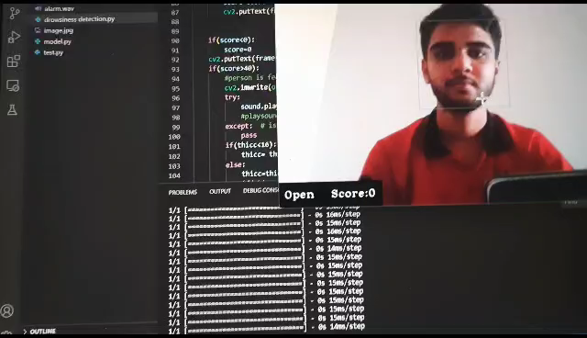
</ Our model

Slide 18
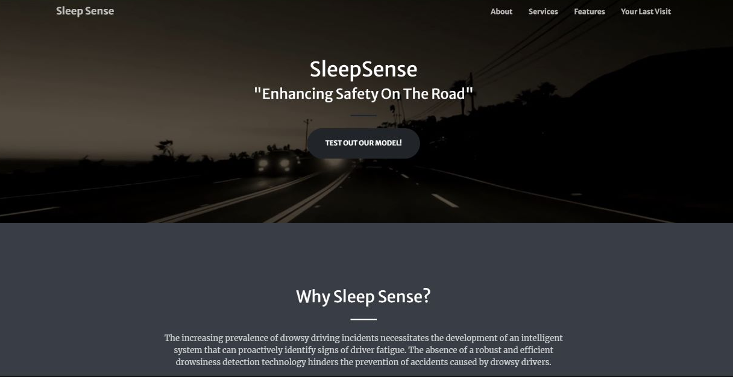
</ DEMO of Webpage

Slide 19
05
Future and beyond
</>
{ / }

Slide 20
</ SleepSense
SleepSense will be a attachment for car which can be powered by a usb cable and provide the functionality it is implementation.
SleepSense utilizes eye-tracking to accurately detect signs of drowsiness in real-time.
When SleepSense detects drowsiness, it immediately sends alerts and warnings to the driver. These can be in the form of audible alarms
SleepSense suggests actions like taking a break, drinking water, opening the window, or playing energizing music. These tailored suggestions help you maintain optimal alertness on the road
SleepSense is designed for hassle-free installation on any car dashboard there is just a 3M tape at bottom peal and stick and then plug that’s it
No downtime! No Internet Required Whatsoever
SleepSense not only detects drowsiness but also collects valuable data on your driving patterns and sleep-related behaviors. By analyzing this data and provides you with insights and reports

Slide 21

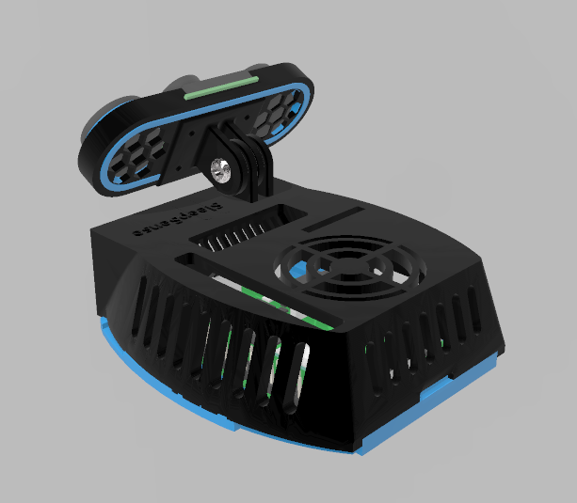
</ Prototype

Slide 22
</ Cost estimates
TOTAL
₹ 7128/- ONLY!

Slide 23
</ Target Audience
Truck Driver
Retail Consumers
Security Firm‘s
Government and Analytics

Slide 24
</ More Advance Truck Manangment System />

Slide 25
</ THANK YOU
/>

